Slide 1

Efficient Execution of Transformers in RISC-V Vector Machines with Custom HW Acceleration
Integrated Systems Laboratory
Xiaorui Yin
Student:
Advisors: Matteo Perotti, Victor Jung (IIS)
Prof. Dr. Luca Benini
Renzo Andri (Huawei ZRC)
Master’s Thesis Aug. 2022
14. Feb. 2023

Slide 2
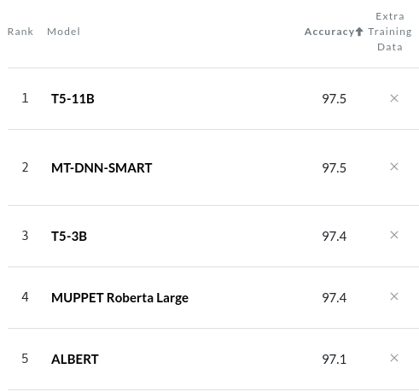
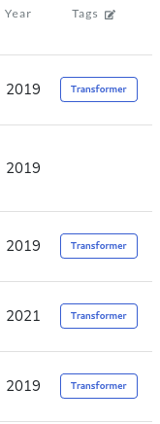


Transformer is Everywhere
1. From Natural Language Processing
SST-2 Binary classification
2. To Image Processing
Input
Attention
Introduction → Motivation → Background → Pre-Analysis → Implementation → Results → Conclusion
1. PaperWithCode, 2. by Jim Clyde Monge
3. Vision Transformer
Notes:
简要介绍transformer的重要性，举例如ChatGPT

Slide 3
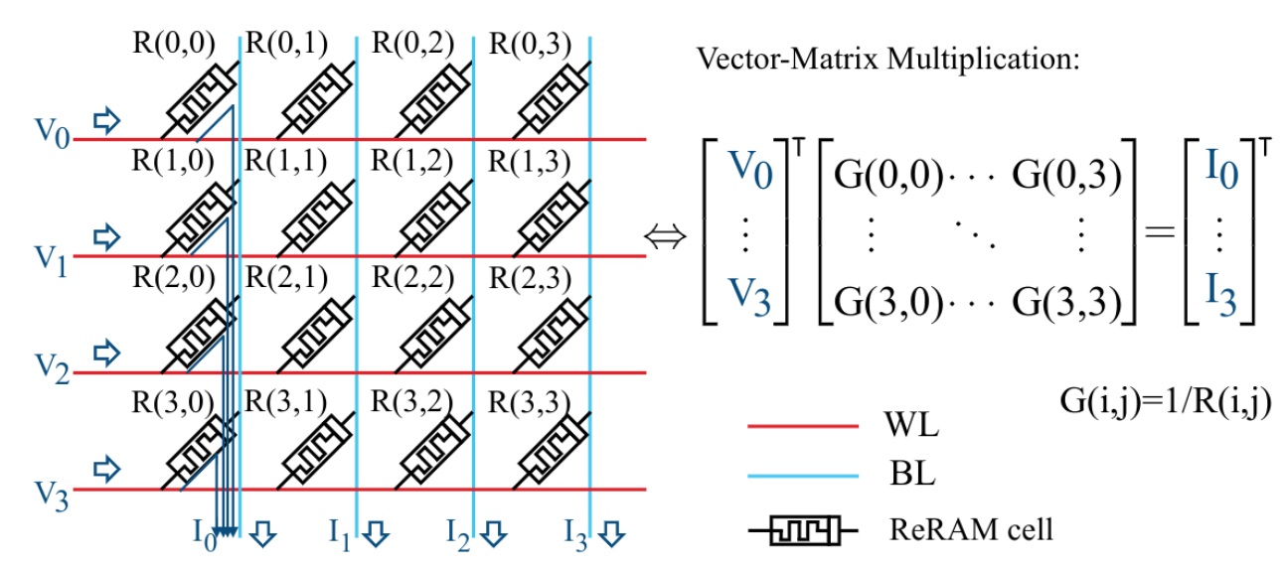
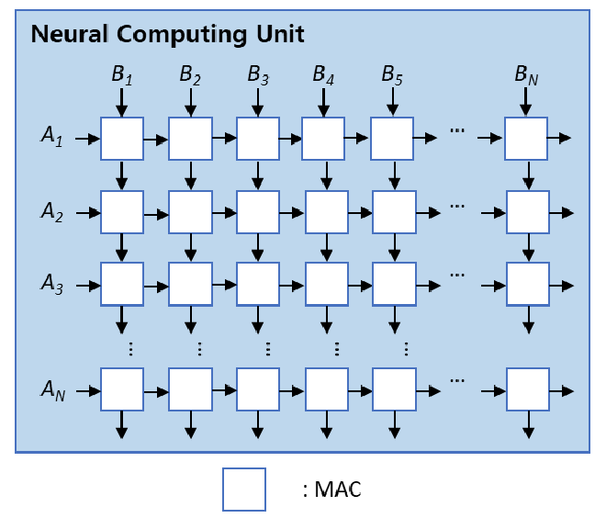
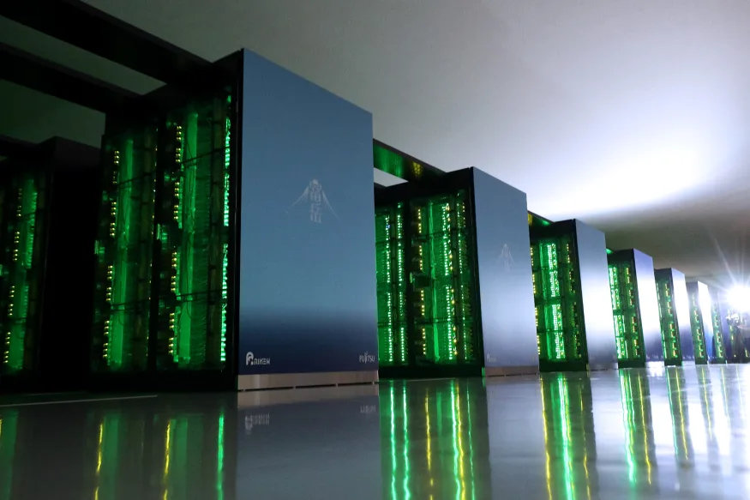
Transformer Accelerator
Systolic Array
Reuse data across one row/column
In-Memory-Computing
Transformer is mainly composed of MatMul
Specialized Accelerators
Best performance for a specific task/model
Lack of flexibility
DNNs evolve rapidly!
Supercomputer: Fugaku
Scalable Vector Extension (SVE)
Vector Processor
General-purpose, easy programmable
Parallel computing, SIMD
Popular in supercomputing
Ara: RISC-V Vector Extension 1.0
Introduction → Motivation → Background → Pre-Analysis → Implementation → Results → Conclusion
1. Efficient Systolic-Array Redundancy Architecture for Offline/Online Repair
2. ReTransformer 3.https://www.engadget.com/japan-fugaku-supercomputer-013121699.html
Notes:
Motivation：尽管有专用的加速器，但他们缺乏灵活性，我们想试试用通用处理器来加速transformer会有什么效果，困难，已经寻找可能的解决办法

Slide 4
Goal & Contribution
Goal:
Explore the capabilities and challenges of vector processors in running the transformer model (inference)
Optimize performance from both hardware and software aspects
Contribution:
Transformer vectorization and performance analysis
New MatMul
(new instructions, hardware)
Transpose the matrices in Transformer
Introduction → Motivation → Background → Pre-Analysis → Implementation → Results → Conclusion

Slide 5
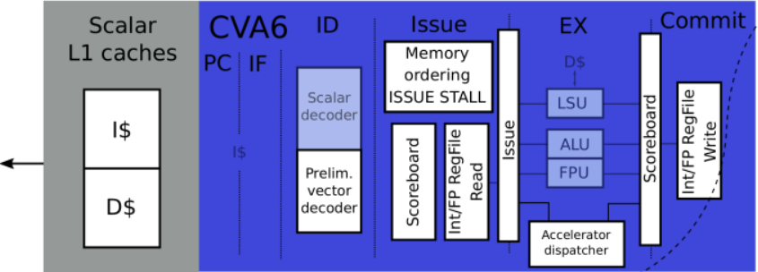
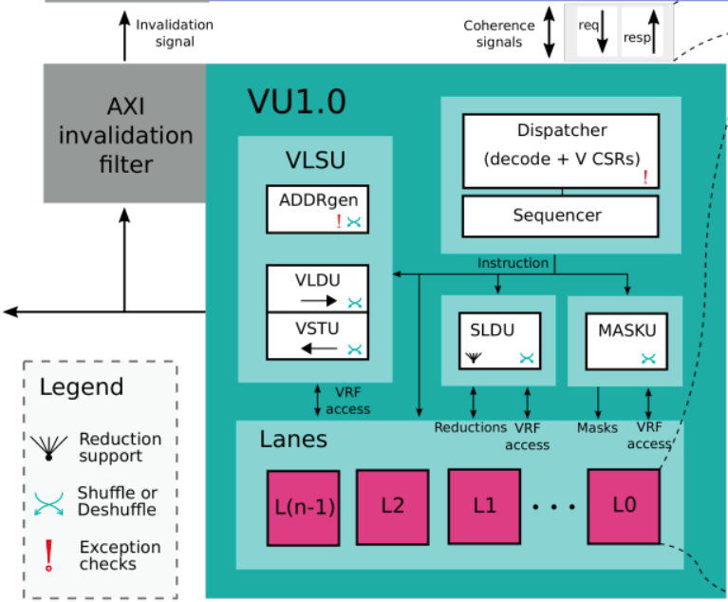
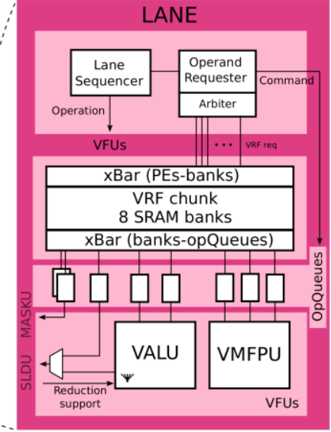
Vector Processor Ara
Scalar Core:
Send vector instructions to the vector unit
VRF:
Store a portion of the vector
1 lane, 1 FPU
VLSU:
memory ←→VRF
Introduction → Motivation → Background → Pre-Analysis → Implementation → Results → Conclusion
Utilization ∝ Throughput
Notes:
一个简短的向量处理器以及Ara的介绍

Slide 6
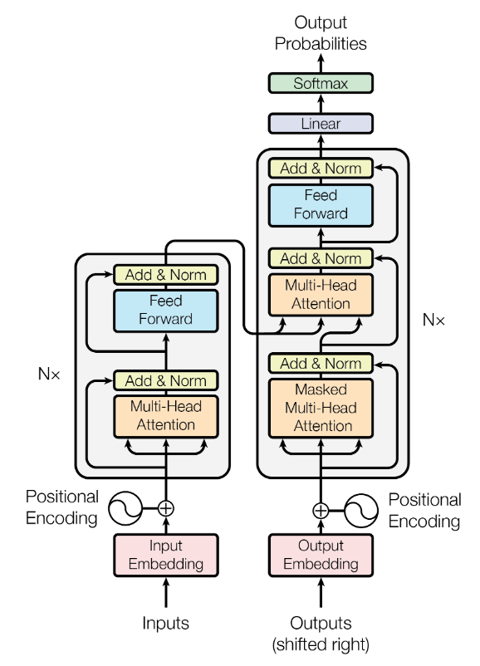
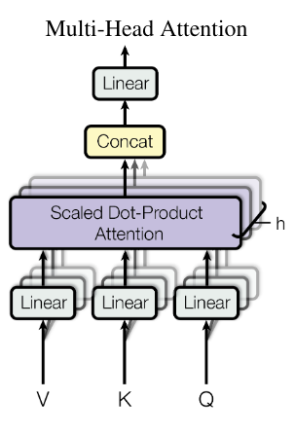
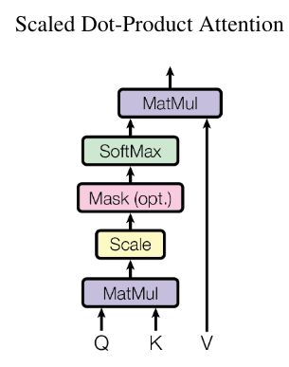
Transformer’s Architecture
Decoder
Encoder
Benchmark
Introduction → Motivation → Background → Pre-Analysis → Implementation → Results → Conclusion
Notes:
Transformer模型结构大致的介绍

Slide 7
Transformer Vectorization: Multihead Attention
d_model x d_model
768x768
n x d_model
64x768
d_model x d_model
768x768
Q
Wo
Wq
MatMul
Bias
h
n x d_model
64x768
n x d_model
64x768
Self-Attention
Self-Attention
K^T
Self-Attention
MatMul
Bias
Residual
Wk
MatMul
Bias
Transpose
Self-Attention
Dropout
LayerNorm
y
x
MatMul
Bias
Wv
V
n | sequence length | 64~512
d_model | model size | 768~1280
h | # heads | 12~16
dk | head size | 64~80
d_ff | Feed Forward size | 3072~5120
n x dk
64x64
Q(i)
n x n
64x64
MatMul
Softmax
S
n x dk
64x64
K(i)^T
MatMul
SA(i)
Introduction → Motivation → Background → Pre-Analysis → Implementation → Results → Conclusion
V(i)

Slide 8
Transformer Vectorization: Multihead Attention
weight matrix (d_model x d_model)
768x768
Wo
h
Output to Feed Forward (n x d_model)
64x768
Multicore System:
Split Wq/Wk/Wv
Calculate Q(i), K(i), V(i) of each head individually
Self-Attention
Self-Attention
Self-Attention
MatMul
Bias
Residual
Self-Attention
Dropout
LayerNorm
y
d_model 768
Wq
Wq(0)
Wq(1)
Wq(2)
Wq(3)
d_model
768
…
dk 64
n x dk
64x64
d_model x dk
768x64
MatMul
Bias
Q(i)
n x n
64x64
MatMul
Softmax
S
n x d_model
64x768
Wq(i)
K(i)^T
MatMul
Bias
Transpose
n x dk
64x64
x
MatMul
SA(i)
Wk(i)
MatMul
Bias
V(i)
Introduction → Motivation → Background → Pre-Analysis → Implementation → Results → Conclusion
Wv(i)

Slide 9
Transformer Vectorization: Feed Forward
d_model x d_ff
768x3072
d_ff x d_model
3072x768
W1
W2
n x d_ff
64x3072
n x d_model
64x768
MatMul
Bias
y’
MatMul
Bias
Residual
ReLU
Dropout
LayerNorm
O
n x d_model
64x768
y
Introduction → Motivation → Background → Pre-Analysis → Implementation → Results → Conclusion

Slide 10
Transformer Vectorization: Individual Kernels
vlmax=4
ReLU & Dropout:
x = 0 if x < 0 or based on a probability (mask)
vl_app = row * col
vl = min(vlmax, vl_app)
vec 1
vec 2
vec 3
vec 4
vec 5
Softmax & LayerNorm:
Elements in a row are dependent
Load column for parallelization (strided load/store)
vl_app = row
vec 1
vec 2
vec 3
vec 4
vec 5
elementwise operations
Introduction → Motivation → Background → Pre-Analysis → Implementation → Results → Conclusion

Slide 11
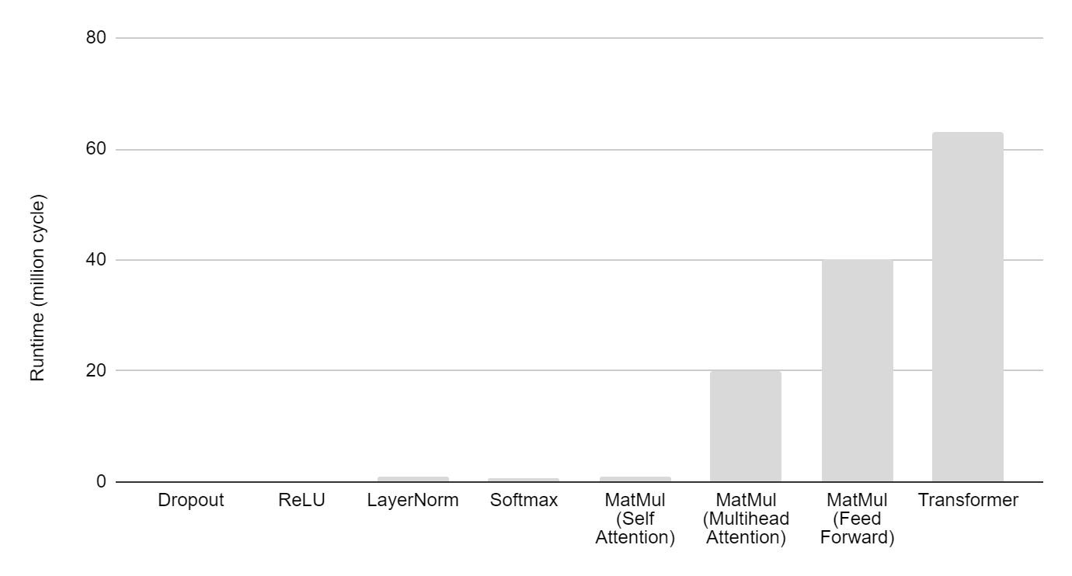
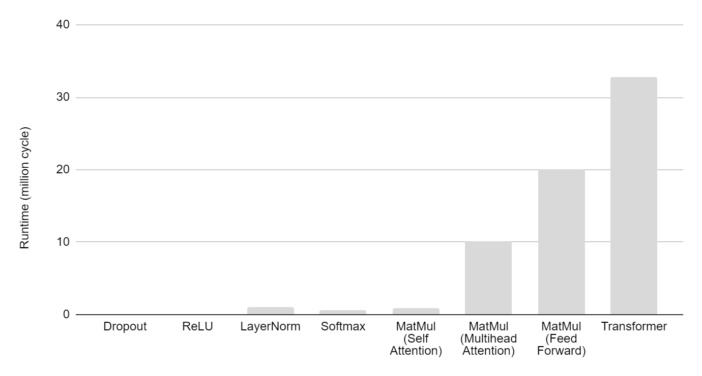
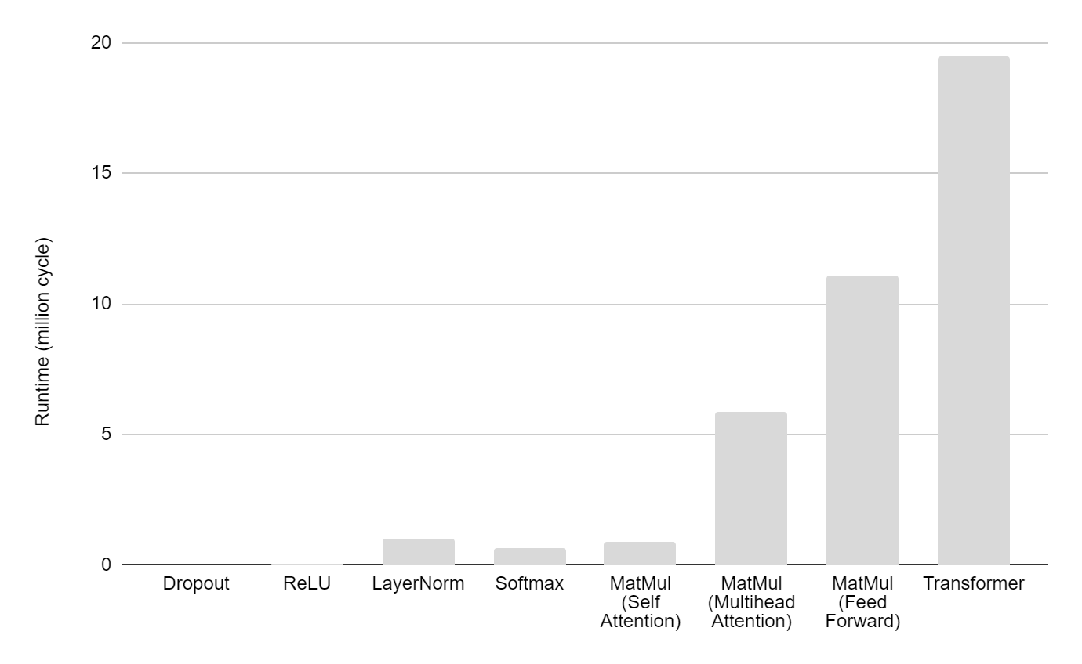
Runtime and Utilization
4 lanes
LayerNorm, Softmax:
memory bounded
limited by strided ops
MatMul (self-attention):
short vl
91%
94%
23%
24%
8%
22%
82%
94%
8 lanes
16 lanes
88%
74%
94%
85%
23%
24%
4%
12%
60%
93%
2%
6%
35%
23%
24%
80%
Introduction → Motivation → Background → Pre-Analysis → Implementation → Results → Conclusion

Slide 12
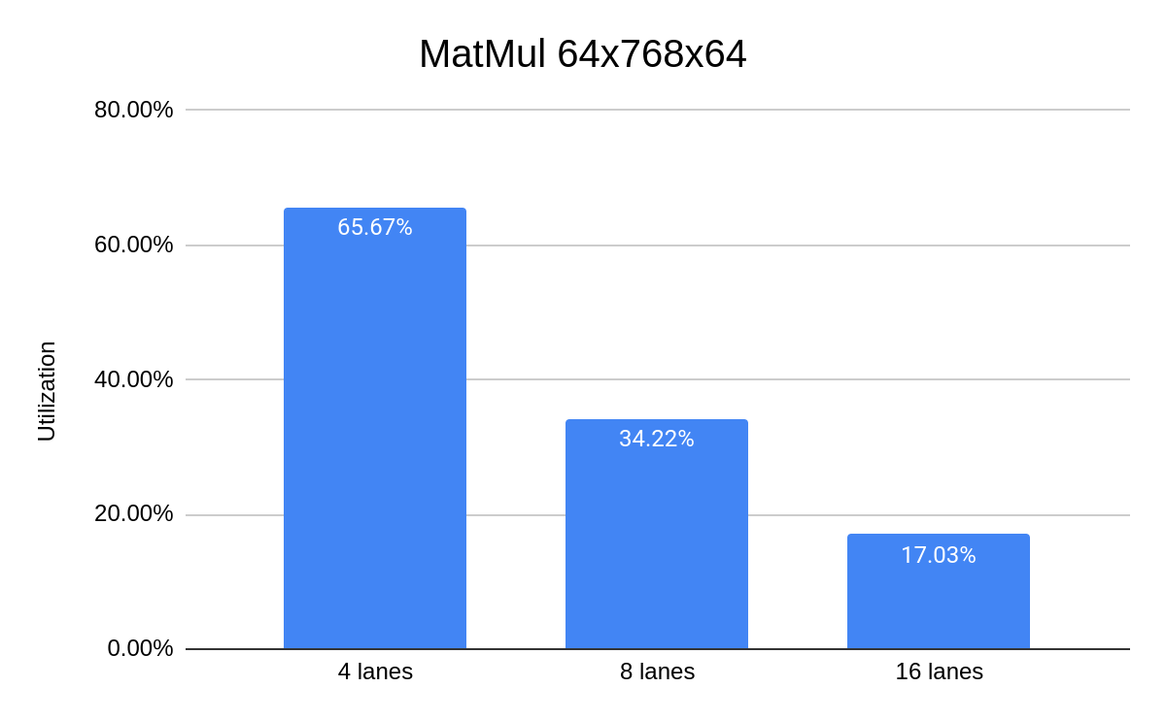
Individual calculation of Q/K/V for each head
vl=64, too short to utilize the hardware
Introduction → Motivation → Background → Pre-Analysis → Implementation → Results → Conclusion

Slide 13
Optimization 1: Improved MatMul with Reduced VL Sensitivity
vl=4
Vanilla MatMul:
vl depends on P (vl <= P)
nr_lanes ↑ nr_elements in each lane ↓
→ utilization ↓
b_vec 0
a
X
Matrix A
MxN
Matrix B
NxP
Matrix C
MxP
Improved MatMul:
Broadcast b_vec to all lanes
Each lane gets sufficient elements
lane 0
lane 0
lane 1
lane 1
# elements = 2
# elements = 4
Introduction → Motivation → Background → Pre-Analysis → Implementation → Results → Conclusion
Notes:
A new way of executing the MatMul

Slide 14
1. Load a_vec to VRF
nr_lanes * reuse_size
a_vec
vl = reuse_size * nr_lanes
Each lane allocates reuse_size(=2) elements
lane 0
lane 1
lane 2
lane 3
VRF
VRF
VRF
VRF
a0, a4
a1, a5
a2, a6
a3, a7
…
…
…
…
FPU
FPU
FPU
FPU
Introduction → Motivation → Background → Pre-Analysis → Implementation → Results → Conclusion

Slide 15
2. Load b_vec to bc_buffer
bl (max 32 for fp32)
b_vec 0
New instructions: vsetbl, vlebc
lane 0
lane 1
lane 2
lane 3
VRF
VRF
VRF
VRF
a0, a4
a1, a5
a2, a6
a3, a7
…
…
…
…
FPU
FPU
FPU
FPU
bc_buffer
b_vec
Introduction → Motivation → Background → Pre-Analysis → Implementation → Results → Conclusion

Slide 16
3. Broadcast elements in b_vec to all lanes
lane 0
lane 1
lane 2
lane 3
VRF
VRF
VRF
VRF
a0, a4
a1, a5
a2, a6
a3, a7
…
…
…
…
FPU
FPU
FPU
FPU
bc_buffer
b_vec
X Backend can be problematic, hard to scale
Introduction → Motivation → Background → Pre-Analysis → Implementation → Results → Conclusion

Slide 17
3. Send elements in b_vec to the first lane
lane 0
lane 1
lane 2
lane 3
VRF
VRF
VRF
VRF
a0, a4
a1, a5
a2, a6
a3, a7
…
…
…
…
FPU
FPU
FPU
FPU
1 clock cycle
bc_buffer
b_vec
: bc_operand_queue
Introduction → Motivation → Background → Pre-Analysis → Implementation → Results → Conclusion

Slide 18
4. Multiply a with b_vec
New instruction: vfbmacc (include step 3)
lane 0
lane 1
lane 2
lane 3
VRF
VRF
VRF
VRF
a0, a4
a1, a5
a2, a6
a3, a7
result 0
result 1
result 2
result 3
result 4
result 5
result 6
result 7
…
…
…
…
FPU
FPU
FPU
FPU
a4 * [b_vec] + ac
a7 * [b_vec] + ac
a0 * [b_vec] + ac
a5 * [b_vec] + ac
a1 * [b_vec] + ac
a6 * [b_vec] + ac
a2 * [b_vec] + ac
a3 * [b_vec] + ac
bc_buffer
b_vec
bl elements in each lane → vl = bl * nr_lanes
Introduction → Motivation → Background → Pre-Analysis → Implementation → Results → Conclusion

Slide 19
5. Store results in memory
New instruction: vssebc
lane 0
lane 1
lane 2
lane 3
VRF
VRF
VRF
VRF
a0, a4
a1, a5
a2, a6
a3, a7
result 0
result 1
result 2
result 3
result 4
result 5
result 6
result 7
…
…
…
…
FPU
FPU
FPU
FPU
VSTU
Support of new instructions:
LLVM Compiler
Spike ISA simulator
More efficient if storing the transposed matrix
Memory
Introduction → Motivation → Background → Pre-Analysis → Implementation → Results → Conclusion

Slide 20
Optimization 2: Transpose the Transformer
Improved MatMul works better with transposed matrix
Softmax LayerNorm
columns → rows (contiguous address)
unit-stride memory ld/st (burst mode)
No negative effect on other kernels
Self-Attention
V(i)^T
Linear Algebra:
SA = S x V
V^T x S^T = SA^T
Q(i)^T
MatMul_t
SA(i)
MatMul_t_at
Softmax
S^T
K(i)^T
Matrix A is transposed (Q(i)^T)
Introduction → Motivation → Background → Pre-Analysis → Implementation → Results → Conclusion

Slide 21
Hardware: Broadcast Buffer
bc_buffer
lane 0
MEM
invalidate when finish
VRF
ADDRGEN
FIFO 0
write
read
…
VLDU
write
read
FIFO 1
FPU
2 * 32 * 32 bits
Introduction → Motivation → Background → Pre-Analysis → Implementation → Results → Conclusion
Notes:
hardware support 1: bc_buffer

Slide 22
Hardware: Broadcast Operand Queue
lane 1
lane 2
VRF
VRF
FIFO
Depth=2
…
…
bc_operand_queue
FPU
FPU
FPU delay
lane-lane delay
broadcast data
Introduction → Motivation → Background → Pre-Analysis → Implementation → Results → Conclusion
Notes:
hardware support 2: broadcast path

Slide 23
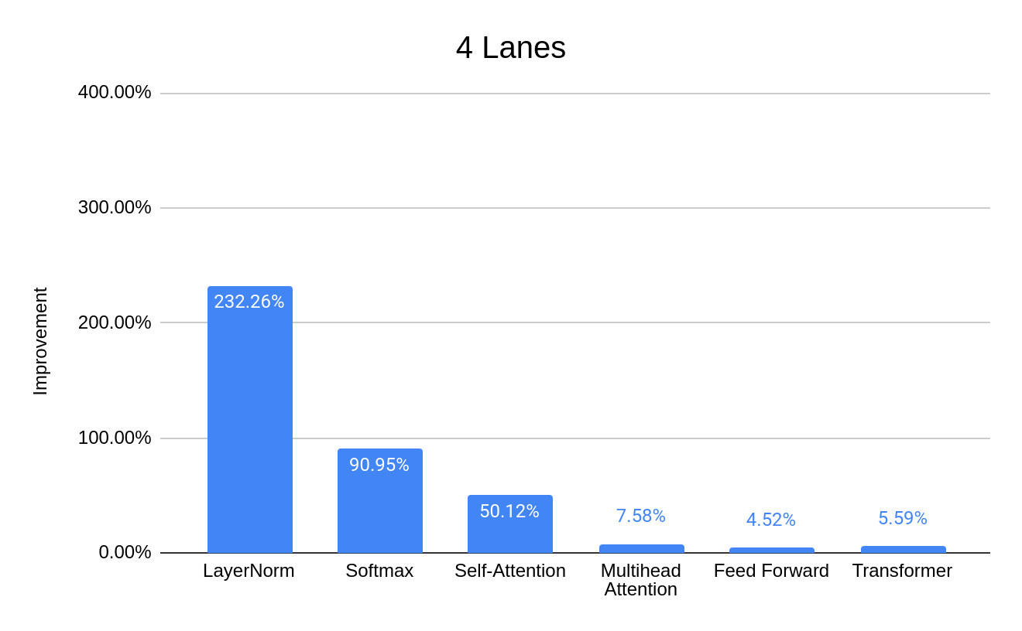
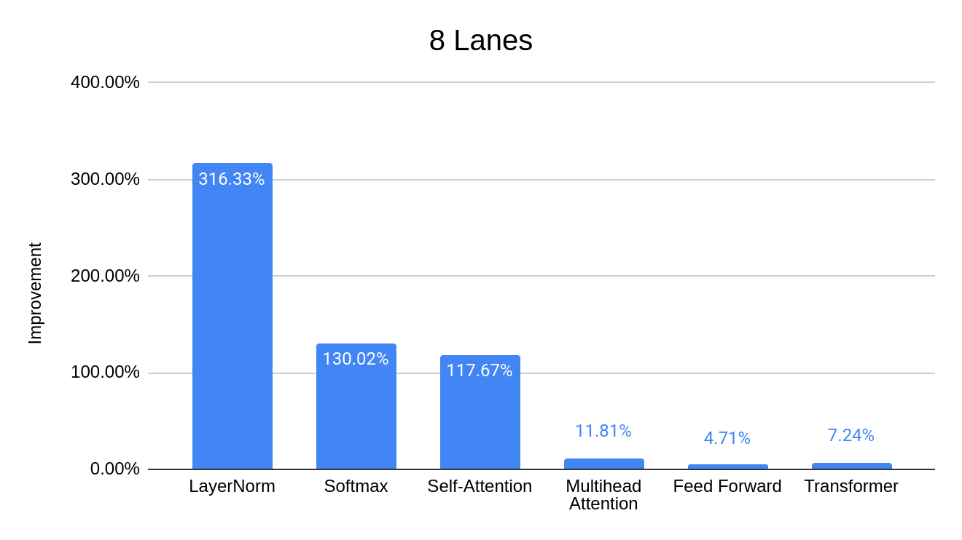
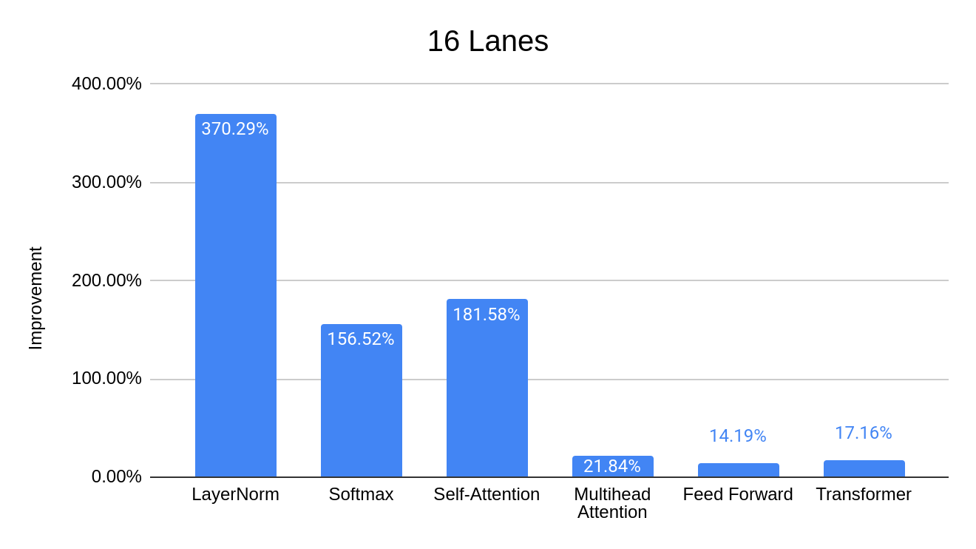
Performance Improvement
Transformer
Introduction → Motivation → Background → Pre-Analysis → Implementation → Results → Conclusion
Notes:
Performance Improvement 1 Each kernel
MatMul

Slide 24
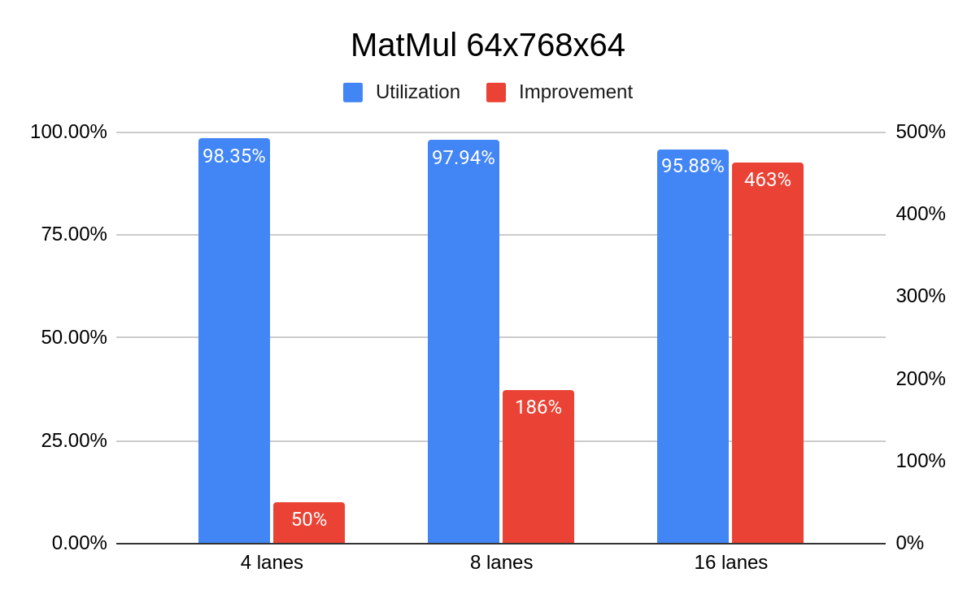
Performance Improvement: Transformer (Parallel Heads)
Estimated improvement for the transformer: 17% 49% 125%
Introduction → Motivation → Background → Pre-Analysis → Implementation → Results → Conclusion
Notes:
Performance Improvement 2 QKV

Slide 25
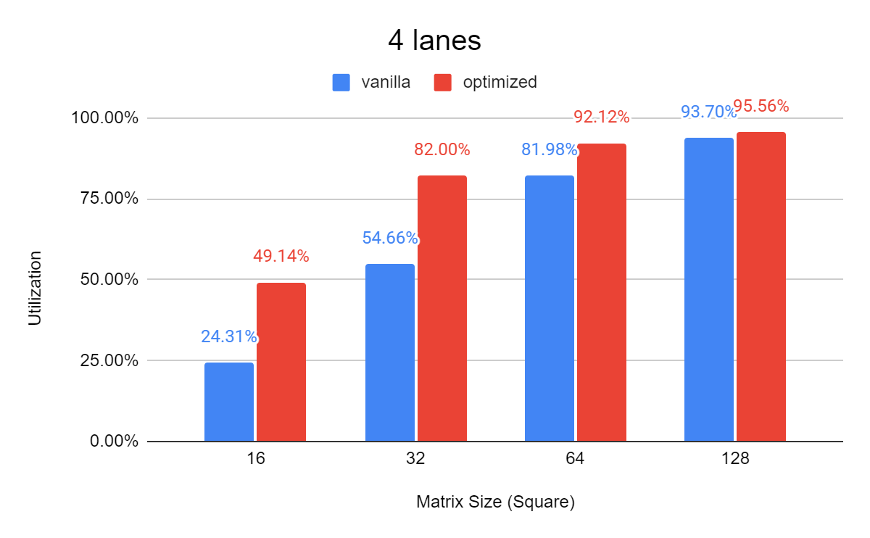
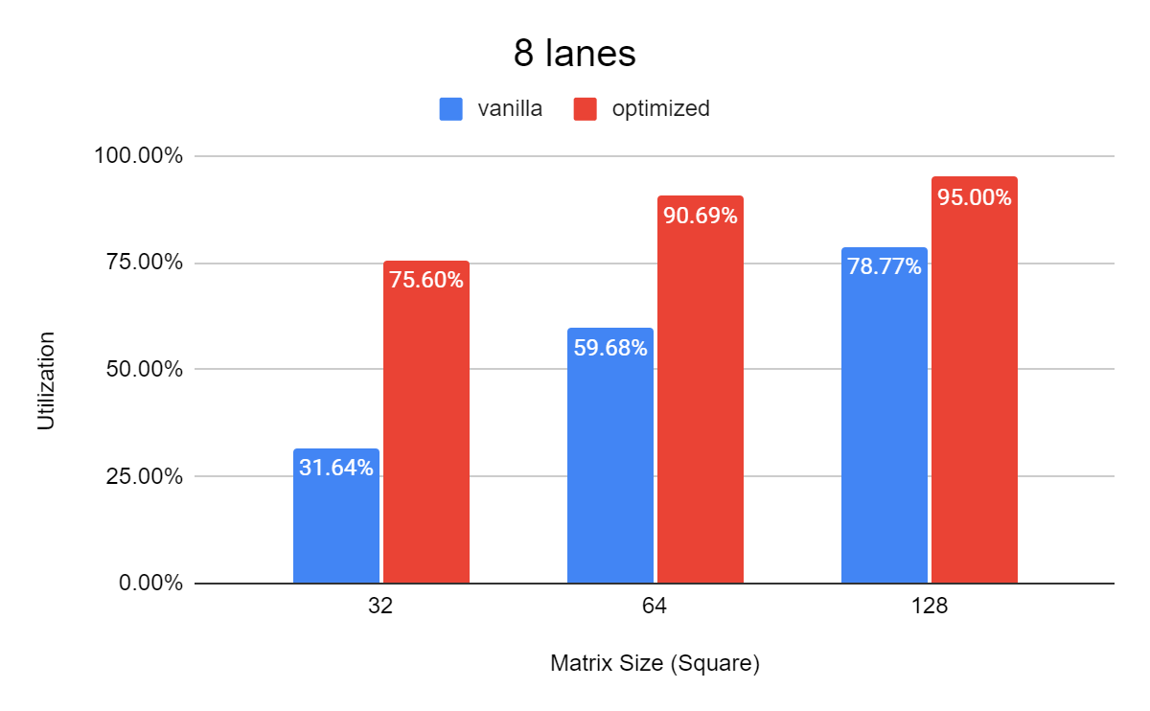
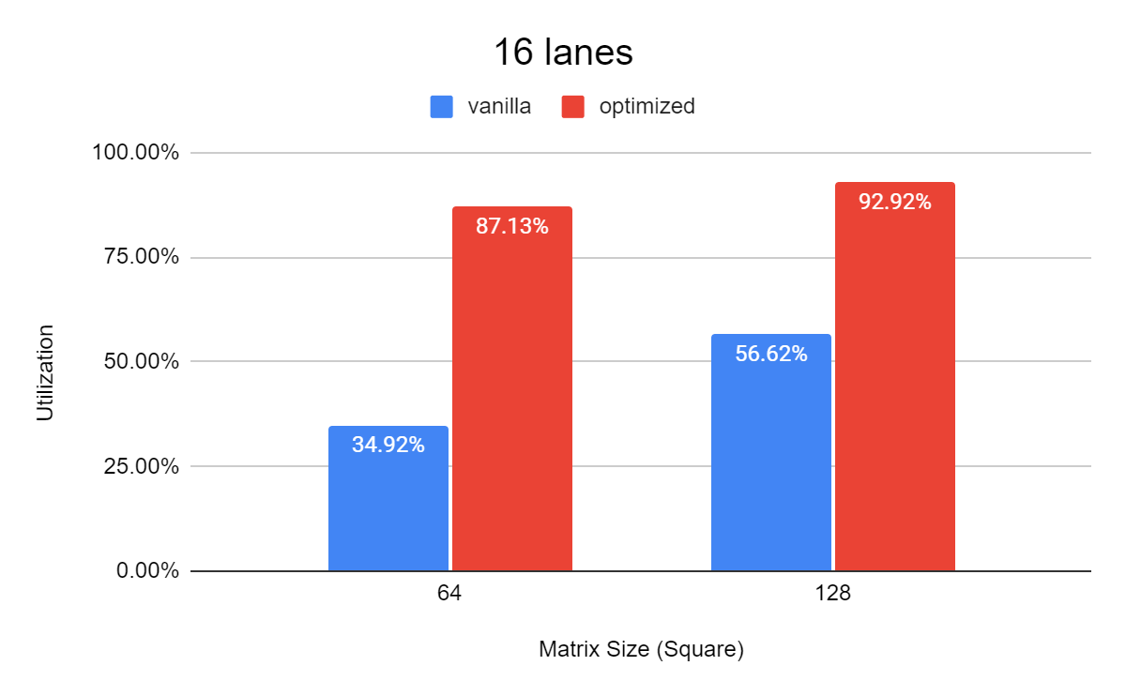
Performance Improvement: Small MatMul
2x
Currently does not support arbitrary dimensions
2.4x
2.5x
Introduction → Motivation → Background → Pre-Analysis → Implementation → Results → Conclusion

Slide 26
Physical Design
Technology: GlobalFoundries 22FDX FD-SOI
Target Frequency: 1GHz
Synthesis: Design Compiler; P&R: IC Compiler II
4-lane & 8-lane (disable mask manipulations)
16-lane not feasible
Floorplan optimization
BC_BUFFER
BC_BUFFER
L2
L3
L0
L3
L0
L1
L1
L2
Critical path
Introduction → Motivation → Background → Pre-Analysis → Implementation → Results → Conclusion
Notes:
Floorplan optimization, flat mode

Slide 27
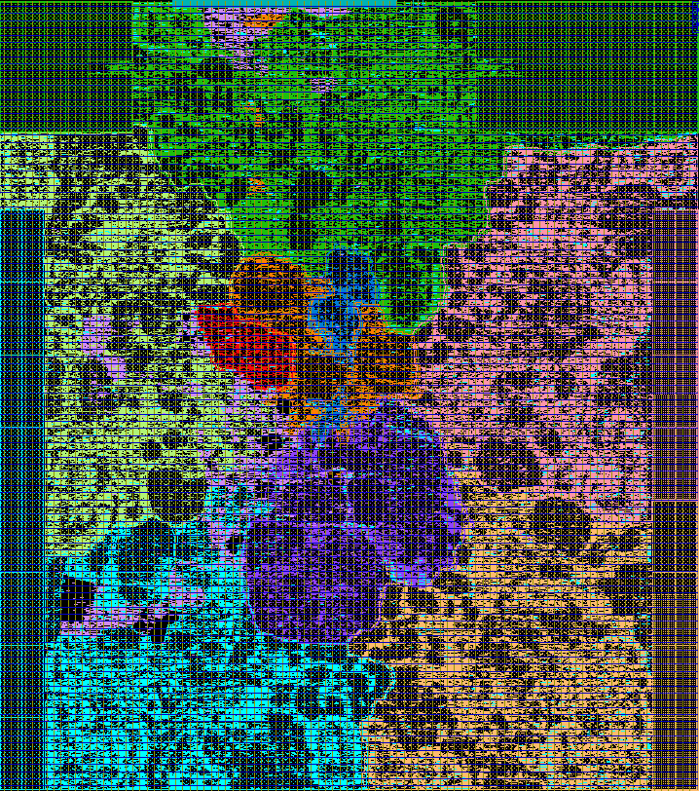
Backend Result
4-lane:
I$
D$
CVA6
 | TT (GHz) | SS (MHz) | Area Utilization | Gate Equivalent (kGE)
Vanilla | 1.34 | 967 | 79.10% | 4362
Modified | 1.33 | 949 | 82.49%
dispatcher
sequencer
bc_buffer
lane 3
lane 0
vlsu
8-lane:
masku
sldu
 | TT (GHz) | SS (MHz) | Area Utilization | Gate Equivalent (kGE)
Vanilla | 1.37 | 943 | 69.94% | 9426
Modified | 1.28 | 903 | 72.53%
lane 1
lane 2
Delay caused by hold-time buffers
Introduction → Motivation → Background → Pre-Analysis → Implementation → Results → Conclusion
Notes:
Backend TC: 1GHz, WC: Area

Slide 28
Power Results
Estimate the transformer power by a small segment of MatMul (64x768x768)
Represent > 95%
 | int (mW) | switch (mW) | leak (mW) | total (mW) | SP-GFLOPS/W | Improvement
Vanilla | 120 | 72 | 10 | 202 | 72.22 | 7.70%
Modified | 110 | 73 | 11 | 198 | 77.78
4-lane
 | int (mW) | switch (mW) | leak (mW) | total (mW) | SP-GFLOPS/W | Improvement
Vanilla | 218 | 153 | 26 | 397 | 70.80 | 13.87%
Modified | 204 | 150 | 27 | 381 | 80.62
8-lane
Introduction → Motivation → Background → Pre-Analysis → Implementation → Results → Conclusion
Notes:
Power Estimation Transformer FLOPS/W different MatMul

Slide 29
Conclusion
Implemented transformers on Ara
Optimizations
Improved Matmul
Transpose the transformer
Transformer speed-up 17% (16-lanes)
Small MatMul: up to 2.5x higher in utilization
Energy efficiency improvement 14% (8-lanes)
Introduction → Motivation → Background → Pre-Analysis → Implementation → Results → Conclusion
Notes:
Conclusion Future Work

Slide 30
Future Work
New MatMul
Transformer
Support for arbitrary matrix sizes
Further improve utilization
Other applications: CNN …
Deploy a more appropriate model
Explore sparsity, low-precision
Introduction → Motivation → Background → Pre-Analysis → Implementation → Results → Conclusion

Slide 31
END

Slide 32
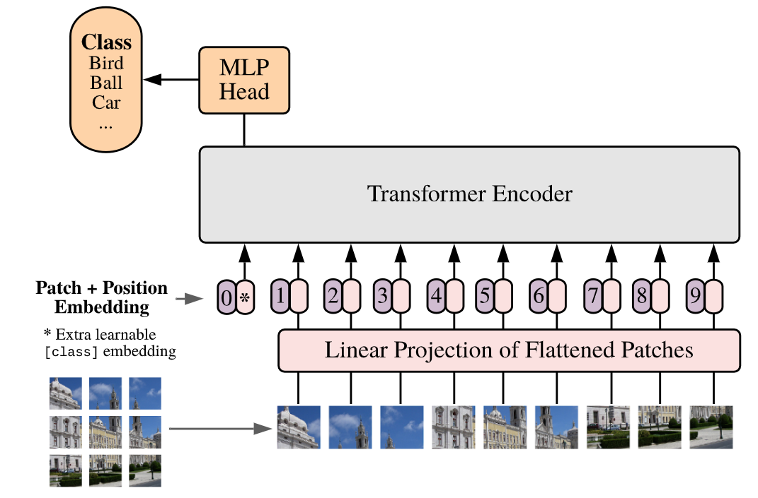
Image processing in transformer

Slide 33
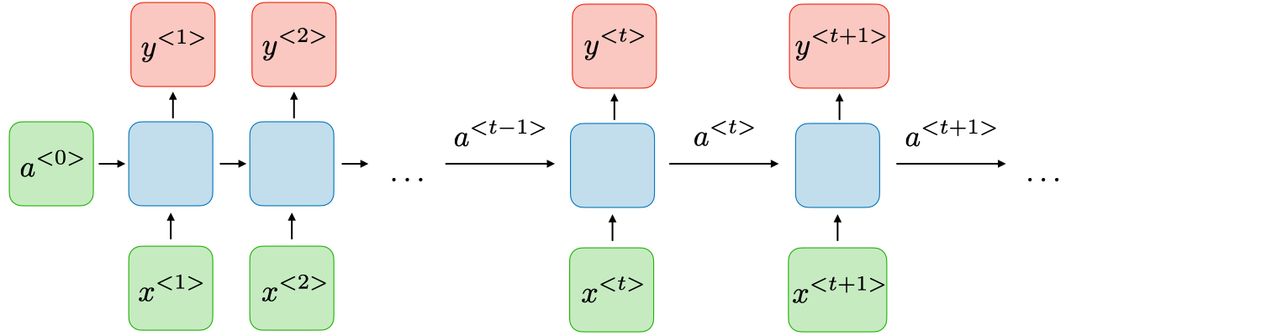
RNN vs Transformers
RNN: y<t> depends on a<0>, …, a<t-1>
Vanishing gradient (chain rule)
Example:
I am a student at ETH. (Cryptocurrency ?)
Struggle to extract long-term dependencies
Transformers: all tokens are equidistant
Parallel processing
Effectively handle long-term dependencies
Add positional encoding to the input tokens

Slide 34
Runtime Distribution
Transformer
Multihead Attention
Feed Forward
35.5%
64.5%
63,176,959 clock cycles
MatMul
Self-Attention x 12
MatMul
Multihead Attention
Feed Forward
89.6%
8.0%
98.4%
LayerNorm+Dropout 2.4%
LayerNorm+ReLU+Dropout 1.6%
MatMul > 95%
MatMul
Softmax
Self-Attention
60%
40%

Slide 35
Runtime and Utilization
4 lanes
91%
94%
23%
24%
8%
22%
82%
94%
8 lanes
16 lanes
88%
74%
94%
85%
23%
24%
2%
6%
60%
93%
2%
6%
35%
23%
24%
80%

Slide 36
Optimization 1: Improved MatMul with Reduced VL Sensitivity
vl
Vanilla MatMul:
vl depends on P
nr_lanes ↑ nr_elements in each lane ↓
A is loaded by the scalar core
a00
b_vec 0
vreg1
a10
vreg2
a20
X
vreg3
a30
vreg4
Matrix A
MxN
Matrix B
NxP
Matrix C
MxP
Improved MatMul:
Broadcast b_vec to all lanes
Each lane gets sufficient elements
Load A into VRF
bl (max 32 for fp32)
b_vec 0
vl = nr_lanes * reuse_size
a_vec
X
Notes:
A new way of executing the MatMul

Slide 37
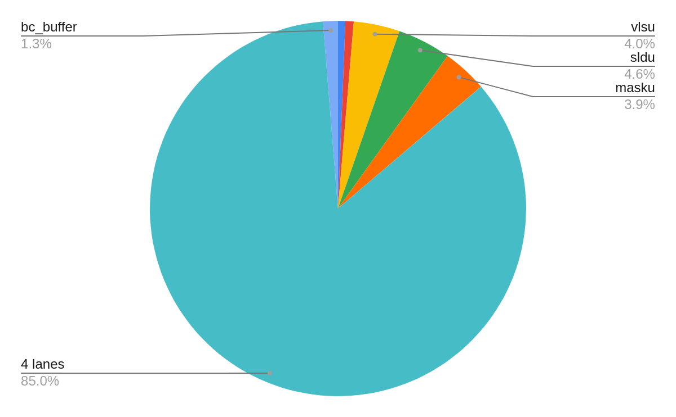
Backend Result
Area:
Cell area utilization: 79.10% → 82.49% (3.39% ↑)
vector unit 100%
Notes:
Backend TC: 1GHz, WC: Area

Slide 38
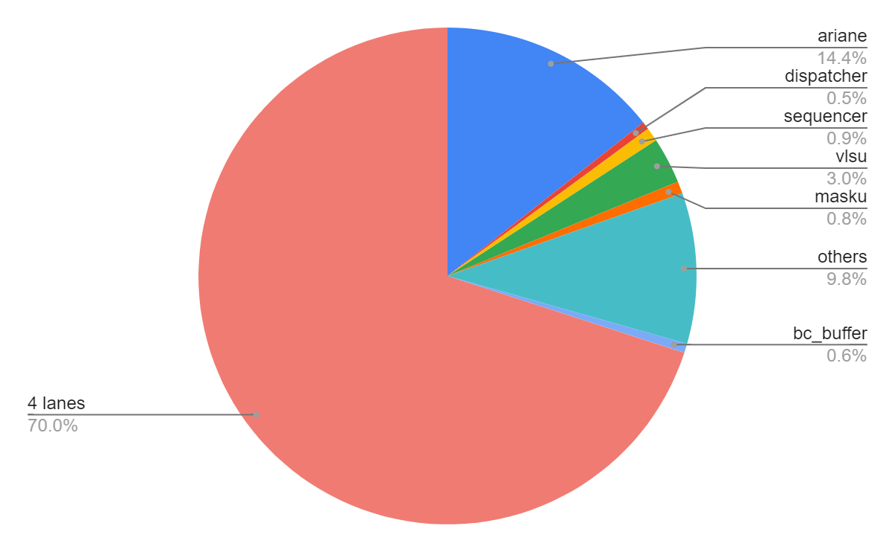
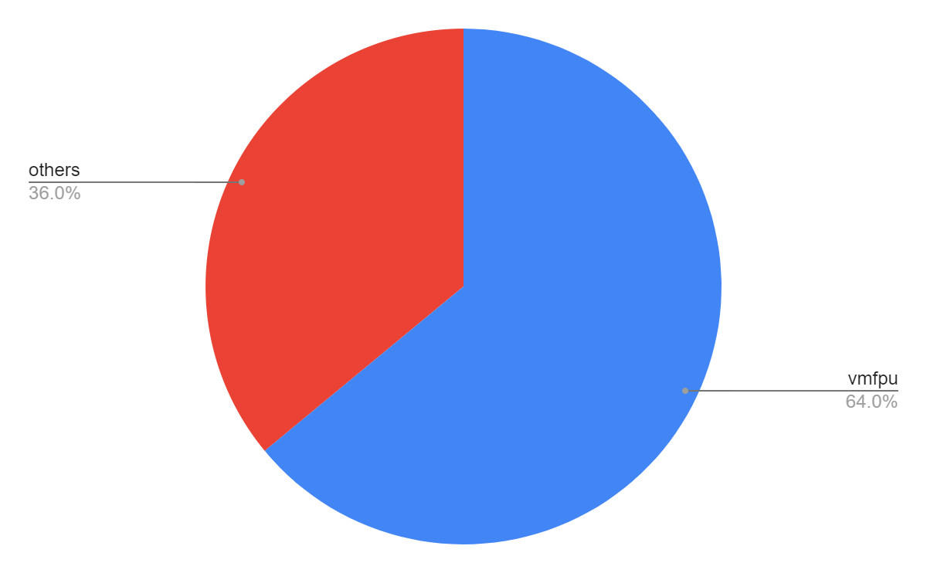
Power Results
Estimate the transformer power by a small segment of MatMul (64x768x768)
Represent > 95%
5.27%
Notes:
Power Estimation Transformer FLOPS/W different MatMul

Slide 39
Critical Path 4-lane
Vanilla (-34ps)
Modified (-52ps)

Slide 40
Critical Path 8-lane
Vanilla (-60ps)
Modified (-86ps)
spill_reg in toplevel
axi_req_o

